Slide 1
Virtual Inheritance in OOP with C++

Slide 2
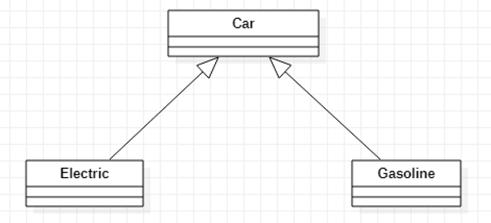
Diamond Problem in Inheritance
Consider the example of a car.
Both electric and gasoline cars inherit the properties of a car.

Slide 3
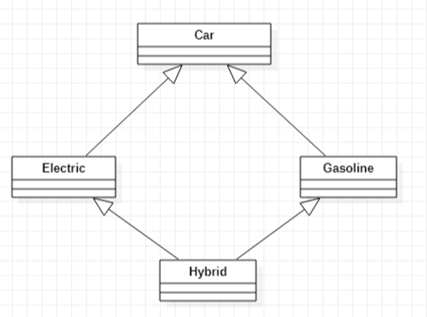
Diamond Problem in Inheritance
The hybrid car is both an electric car and a gasoline car. These kinds of special cases will result in a diamond problem.

Slide 4
Diamond Problem in Inheritance
The hybrid car is both an electric car and a gasoline car. These kinds of special cases will result in a diamond problem.
This diamond creates a problem, because now the Hybrid class has two copies of the Car class for each path.

Slide 5
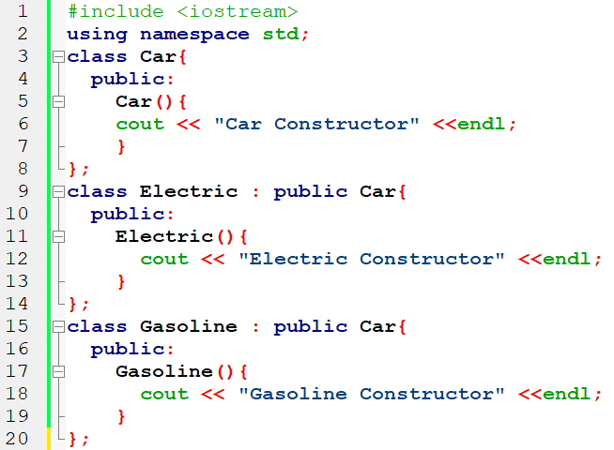
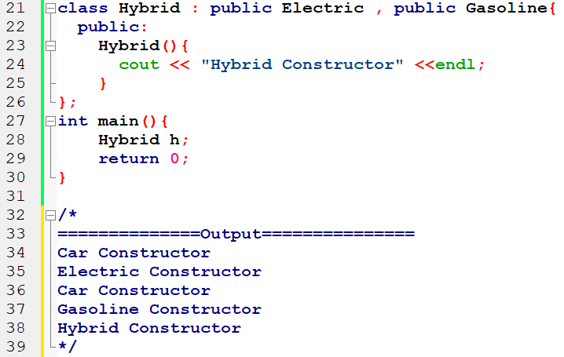
Diamond Problem Implementation

Slide 6
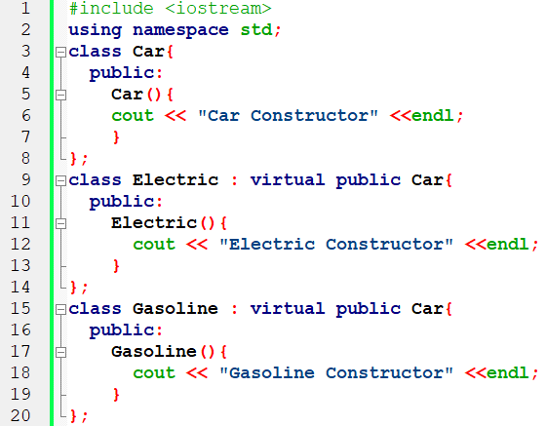
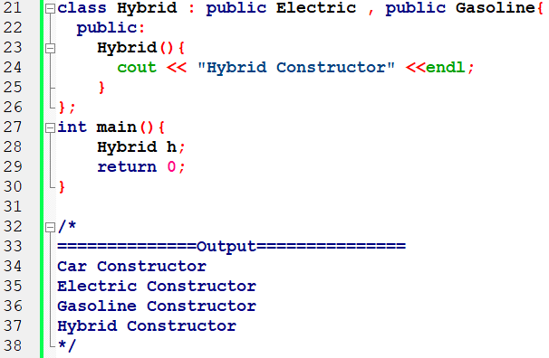
Solution of Diamond Problem

Slide 7
Solution of Diamond Problem
Virtual can be written before or after the public.
Now only one copy of data/function member will be copied to class Electric and class Gasoline and class Hybrid becomes the virtual base class.
Virtual base classes offer a way to save space and avoid ambiguities in class hierarchies that use multiple inheritances. When a base class is specified as a virtual base, it can act as an indirect base more than once without duplication of its data members. A single copy of its data members is shared by all the base classes that use virtual base.

Slide 8
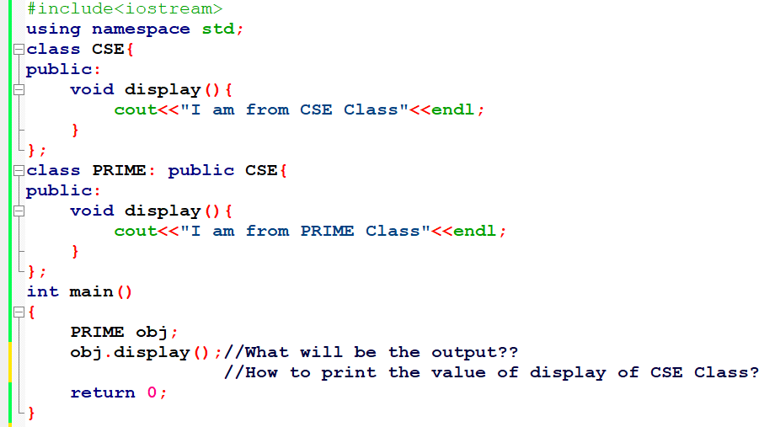
Special Case of Inheritance

Slide 9
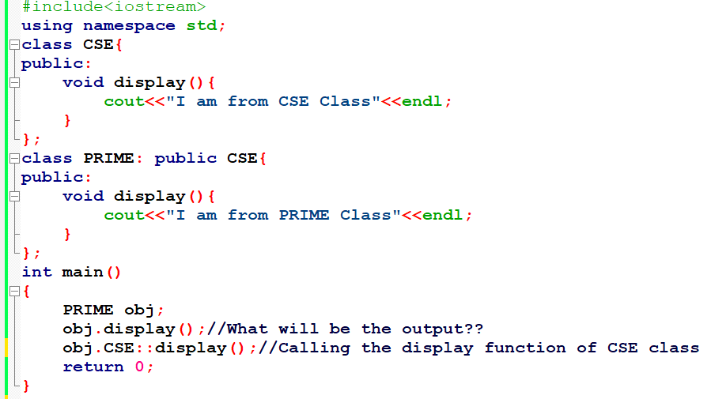
Special Case of Inheritance

Slide 10
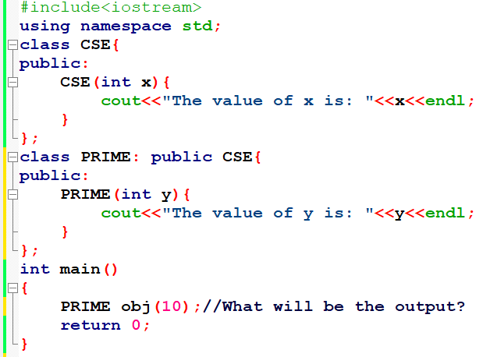
Special Case of Constructor in Inheritance

Slide 11
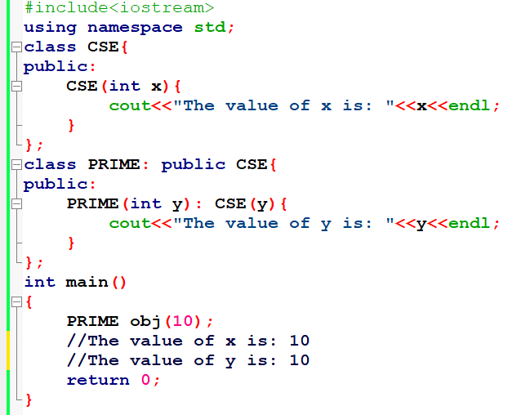
Special Case of Constructor in Inheritance (Solution)

Slide 12
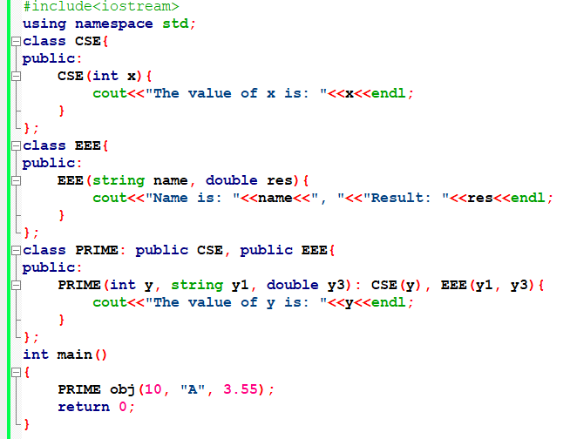
Special Case of Constructor in Inheritance (Solution)

Slide 13
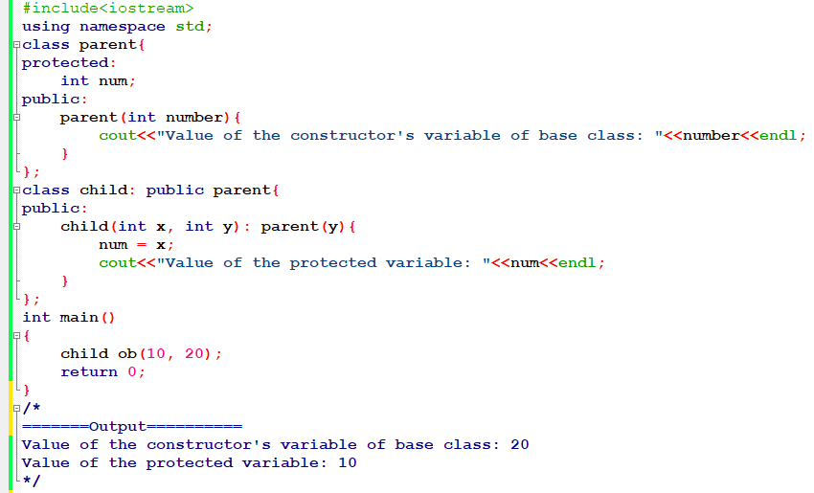
Special Case of Constructor in Inheritance (Solution)

Slide 14
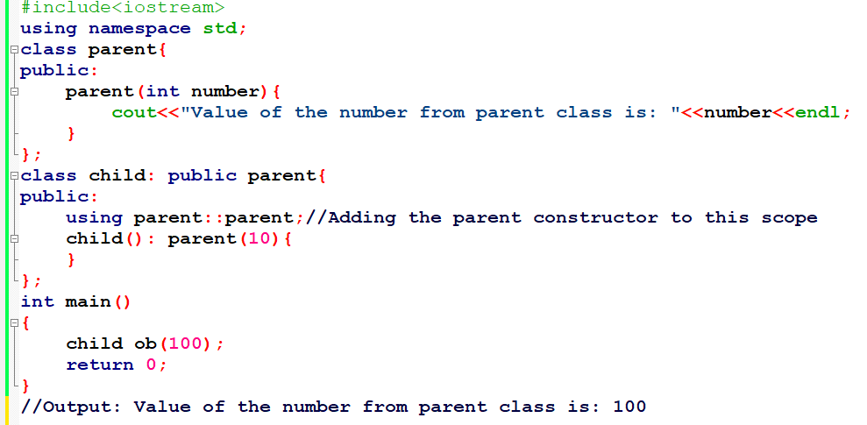
Very Special Case of Constructor in Inheritance (Solution)

Slide 15
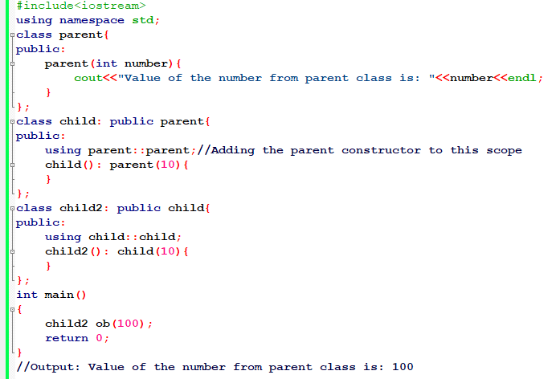
Very Special Case of Constructor in Inheritance (Solution)

Slide 16
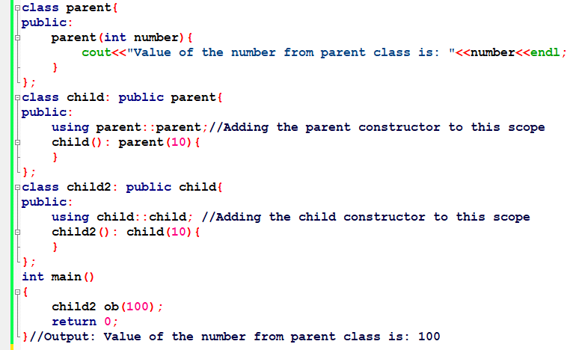
Very Special Case of Constructor in Inheritance (Solution)

Slide 17
Practice Example (1)
Implement the following description using C++ language:
Create a class “Bank”. Declare private variables like BankID, BankName, and Location and a class constructor that can take any two of declared parameters. And write a function Print_Values() that can print the constructor’s values.
Create another class “Customer”. Declare class constructor that can take two parameters like Customer_ID and Amount. And write a function Print_Values2() that can print the constructor’s values. Inherit the Bank class from the Customer class.
By creating the main function call the Print_Values2 function of the Customer class.

Slide 18
Practice Example(02)
Write a program in C++ with the following description:
Create three classes “CPP”, “PYTHON”, and “JAVA” with Private Data Members: Invention_Year, Invented_Country. Public Member Functions: A parameterized constructor to take and assign values to the data members and print those values.
Inherit the “CPP”, and “PYTHON” classes from the “JAVA” class.
Now test the program by creating an object of the “JAVA” class.

Slide 19
Thank You

